Slide 1
Case Study 5: ToyJoy’s Seasonal Inventory Management FY 2023 – 2025
Sai Jhansi Kongara
Student at Sharpener Tech

Slide 2
AIM
To analyze ToyJoy's seasonal inventory Management, a company that sells toys through both retail stores and online channels.to provide necessary business recommendations to identify overstocked and high-demand items, forecast seasonal trends, and recommend actionable inventory adjustments.
Business Objectives
Identify products with high overstock and low sales.
Predict demand trends based on seasonality and historical sales.
Recommend inventory adjustments to minimize waste and lost sales.
Tools Used:
Microsoft Power BI
Spreadsheet
ChatGPT

Slide 3

Business Analysis

Slide 4
4000 ToyJoy_Seasonal Inventory Management Data Entries FY 2023-2025
Dataset & EDA
Chatgpt driven Dataset.
Replacing null Values are with “0”, Blank Text entries with “Unknown".
Excessinventoryvalue=(Units_Sold-UnitsInStock/inventory)*Unit_Cost
ReorderAlert:Indicates whether a product needs to be reordered based on current inventory levels =IF(UnitsInStock/inventory<Reorder_Point,"Reorder Needed","Stock Sufficient") Indicates whether a product needs to be reordered based on current inventory levels

Slide 5
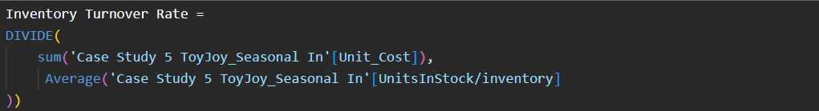
DAX Measures
High turnover rate: fast-selling products and efficient inventory management.
Low turnover rate: Overstocked or slow-moving products.

Slide 6
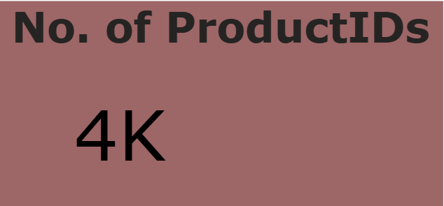
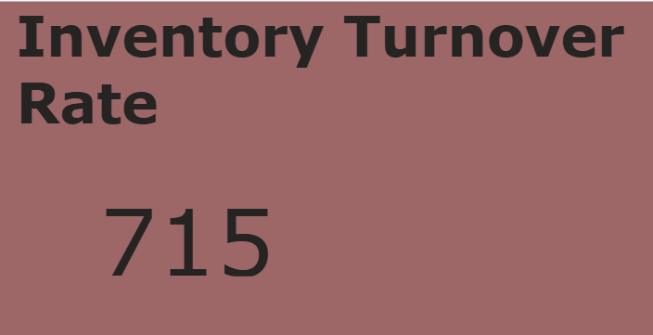
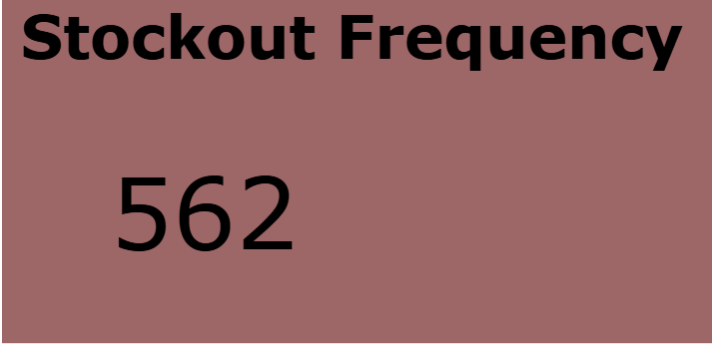
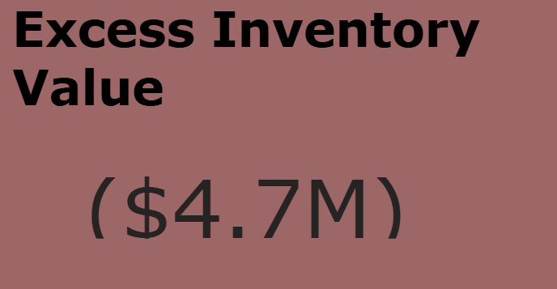
KPI Summary
$4.7M spend on the product which are still in the inventory

Slide 7


Business Insights
and Recommendations
in terms of Quick wins and long-term strategies

Slide 8
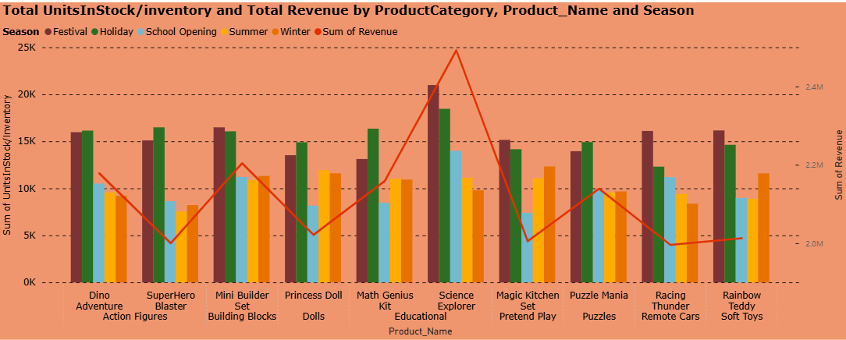
Revenue Trends
Science Explorer from Educational Category generated highest Revenue compared to other categories.
Festival season generated the highest sales.
Pretend Play and remote Cars have Stock but have less Sales, leading to excess inventory costs

Slide 9
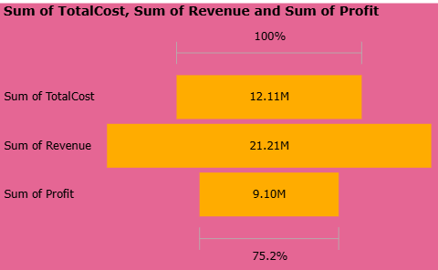
Revenue Trends
Quick wins(0–3 Months)Recommendations to actions:
Increase inventory for fast-selling seasonal products before holidays and school reopening periods.
Long-term strategies(3–12 Months)
Improve warehouse space utilization through inventory optimization.
Numerical Statistics:

Slide 10
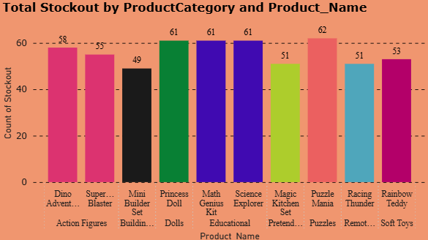
Stockout Analysis
Puzzles faced higher stockout risks. Reason might be Products were not reordered in time when inventory approached the reorder point.

Slide 11
Stockout Analysis
Quick wins:
Increase stock for high-demand seasonal products.
Prioritize restocking fast-moving products.
Long-term strategies:
Improve supplier coordination.

Slide 12
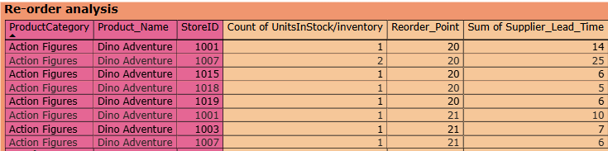
Reorder Analysis
This is a table, the purpose of this analysis is to identify products that are operating below their reorder levels and may face stockout risks
Reduces stockout situations
Prevents loss in sales

Slide 13
Reorder Analysis
Quick wins:
Implement reorder alerts.
Long-term strategies:
Optimize reorder points dynamically.

Slide 14
Conclusions
The Case Study analyzed ToyJoy's seasonal inventory Management to provide necessary business recommendations to identify overstocked and high-demand items, forecast seasonal trends, and recommend actionable inventory adjustments.
Science Explorer from Educational Category generated highest Revenue compared to other categories.
Festival season generated the highest sales, while some products such as Pretend Play and Remote Cars showed high inventory but low sales performance, leading to increased storage costs.
The Case Study also highlighted the importance of reorder planning and supplier lead time management to reduce stock shortages and improve product availability.
Based on the findings, recommendations were provided to optimize inventory levels, improve seasonal forecasting, implement reorder alerts, and enhance inventory planning strategies.

Slide 15

THANK YOU
Any Questions/feedback?
Check out Working Model Here:
Case Study 5 ToyJoy_Seasonal Inventory Management
Connect me at:
Sai Jhansi Kongara

